Slide 1

Adidas
Sales & Price analysis
During the Pandemic
Group C : Bin, Hayoung, Mayank, Meenakshi, Rahull

Slide 2

Dataset Overview
US Adidas Monthly Sales Dataset For 2020-2021
9600 Observations
(From 2020 to 2021)
6 Products
Retailer Name/ID
Price Per Unit
Units Sold
Sales Revenue
Operating Profits and Margin
52 Cities
50 States
3 Sales Channels

Slide 3



Problem Statement
Project Objective
Methodology
Suggestion
Investigate the impact of Covid-19-induced shifts in consumer behavior and retail dynamics on the price sensitivity of Adidas product consumers
Analyze price elasticities across different sales channels, regions, and product categories during the years 2020-2021
Offer Adidas the overall consumer behavior insights during pandemic across different geographies and products
Notes:
Project Purpose
The project aims to investigate the impact of Covid-19-induced shifts in consumer behavior and retail dynamics on the price sensitivity of Adidas product consumers.
Methodology
By analyzing price elasticities across different sales channels, cities, and product categories during the years 2020-2021, we seek to understand how pricing strategies can be optimized in response to the evolving market conditions. Based on this analysis, we would like to offer Adidas the overall business insights about this pandemic situation as well as possible pricing strategies across different sales dynamics.

Slide 4
TABLE OF CONTENTS
01
02
03
04
EDA
Predictive Models
Price Elasticities
Conclusion & Suggestion
Notes:
2. Regression - To find out the significant and impactful variables
Multiple Linear Regression & RandomForest Regressor

Slide 5

01
Exploratory
Data Analysis

Slide 6
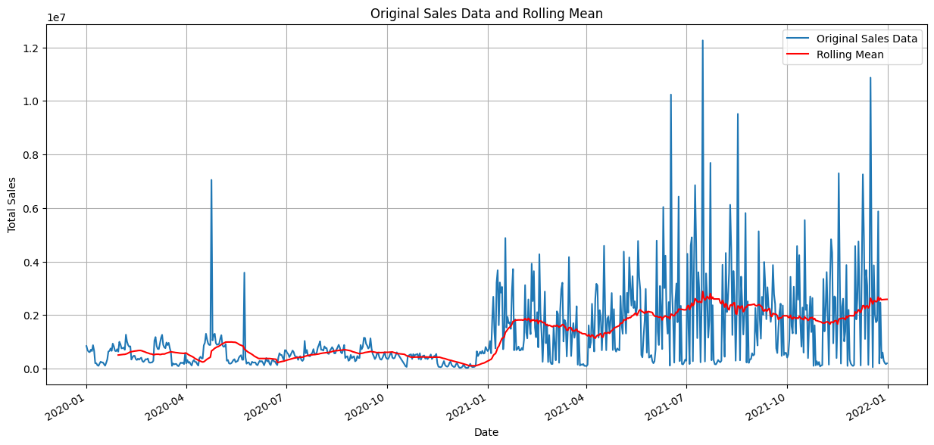
Sales Revenue in 2020 & 2021
Clear dip observed around the early to mid-2020, likely due to the impact of the COVID-19 pandemic
Sales seem to recover somewhat after the dip and maintain a relatively consistent level towards the end of the year
Rolling Mean: Window=30
Notes:
Based on our EDA, one of our hypothesis was that
For the second graph - while Online remained its price per unit in the middle level, it made best out of it given its highest level of units sold.

Slide 7
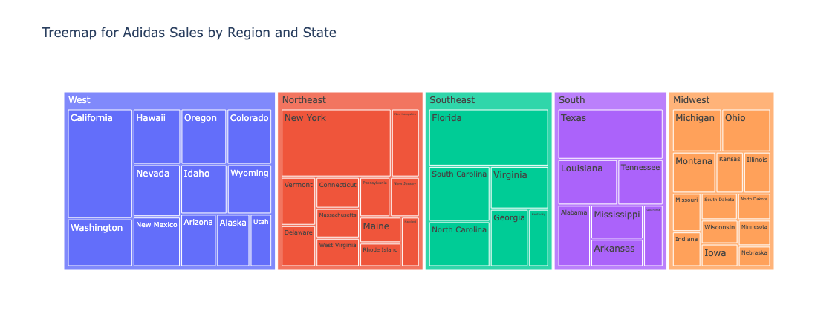
Sales Revenue By Region
California, New York, Florida, Texas, and Michigan recorded the highest sales in 2020-2021
Notes:
Based on our EDA, one of our hypothesis was that
For the second graph - while Online remained its price per unit in the middle level, it made best out of it given its highest level of units sold.

Slide 8
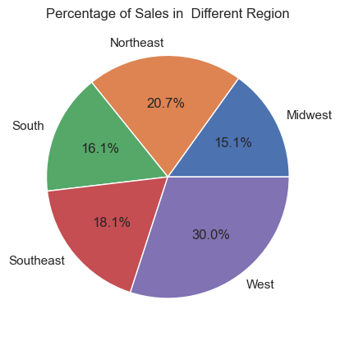
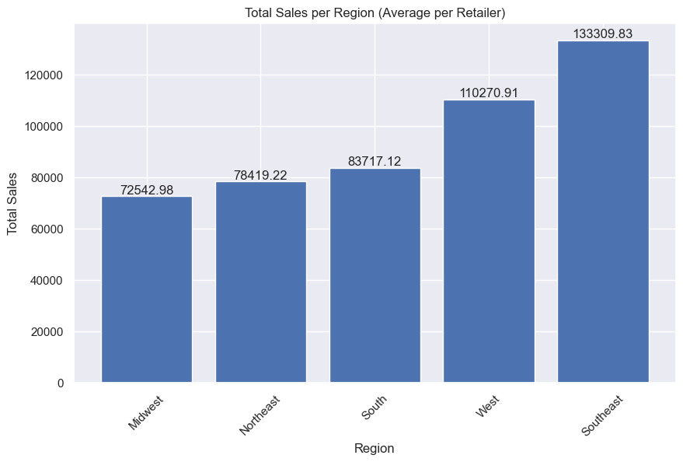
Sales Revenue By Region
Average Sales Revenue per Retailer
Sales Revenue Share per Region
West leads in total sales; Southeast in retailer average.
Northeast's second in total sales contrasts with its near-bottom retailer average, indicating relatively high sales variance among retailers.
Notes:
Based on our EDA, one of our hypothesis was that
For the second graph - while Online remained its price per unit in the middle level, it made best out of it given its highest level of units sold.

Slide 9
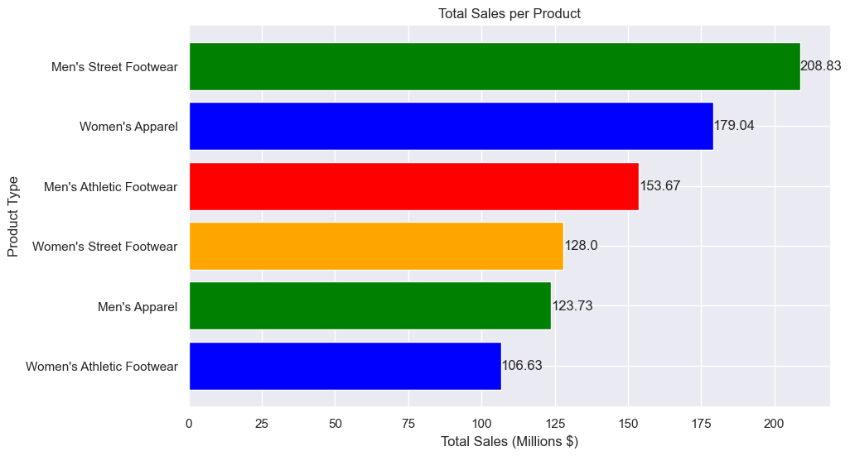
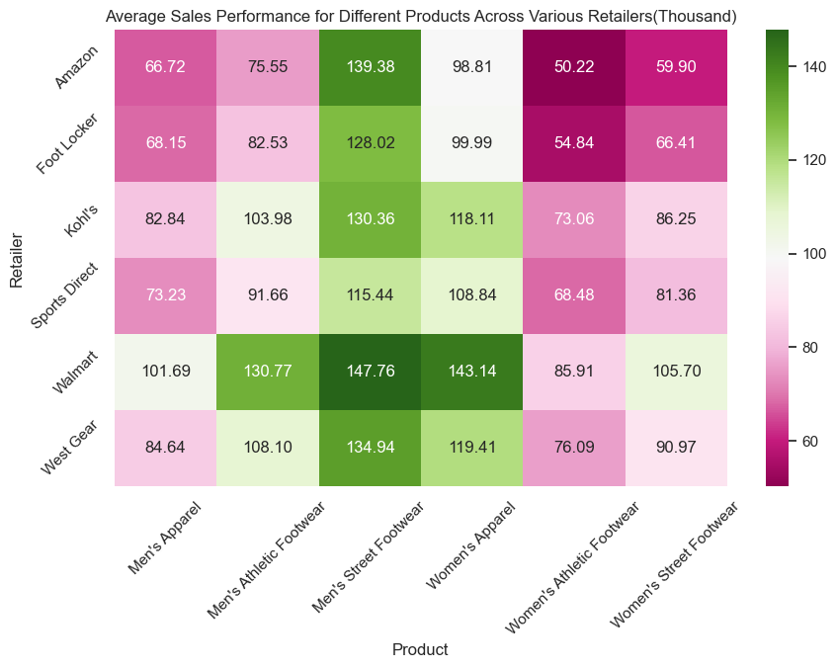
Sales Revenue by Product
Sum Total Revenues per Product (Million$)
Average Sales Revenue for different Products across Retailers ($k)
Total Sales are most notable for Men's Street Footwear and Women's Apparel
Walmart holds the sales lead in all top three categories.
Notes:
Based on our EDA, one of our hypothesis was that
For the second graph - while Online remained its price per unit in the middle level, it made best out of it given its highest level of units sold.

Slide 10
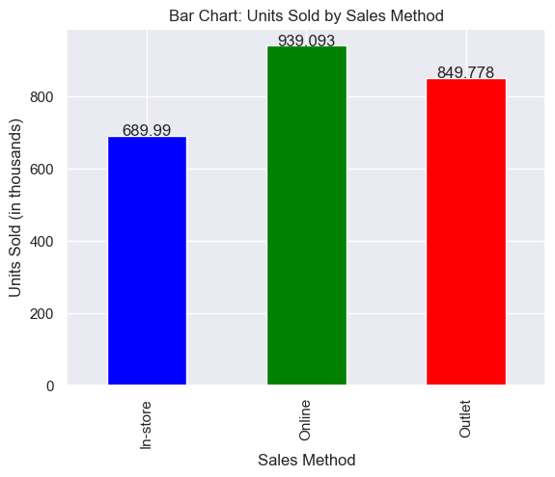
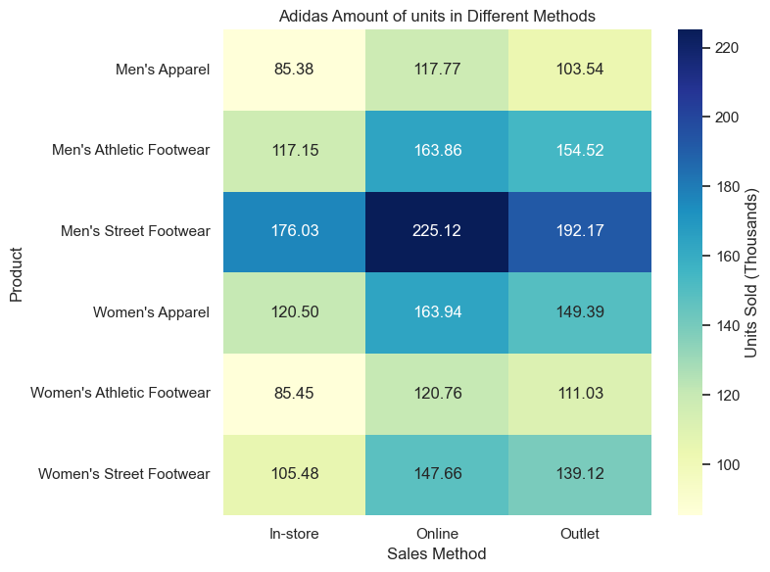
Units Sold (Sales) by Channel
Units Sold by Channel (in thousands)
Units Sold of product by Channel (in thousands)
The highest number of products were sold online
Men's Street Footwear is the best-selling product across all channels, with online sales recording the highest units sold for all products
Notes:
Based on our EDA, one of our hypothesis was that
In the second graph, even though online channel maintained moderate prices per unit, it achieved optimal performance in sales volume by selling a large quantity of units

Slide 11
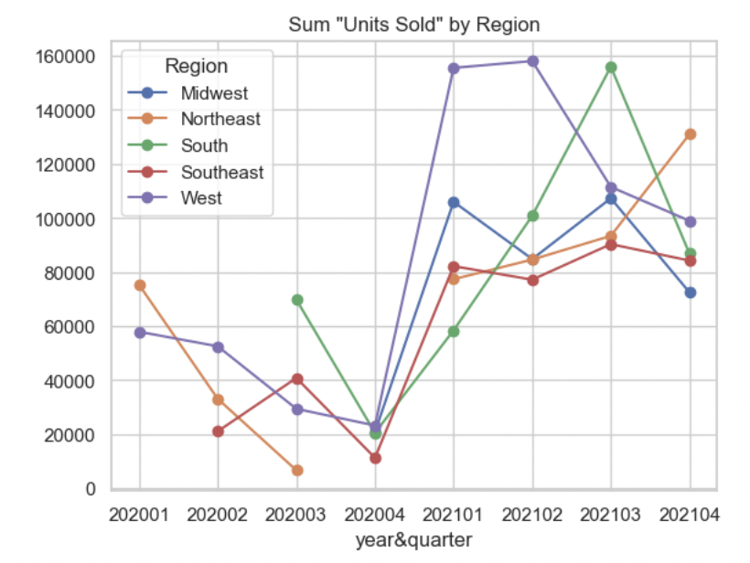
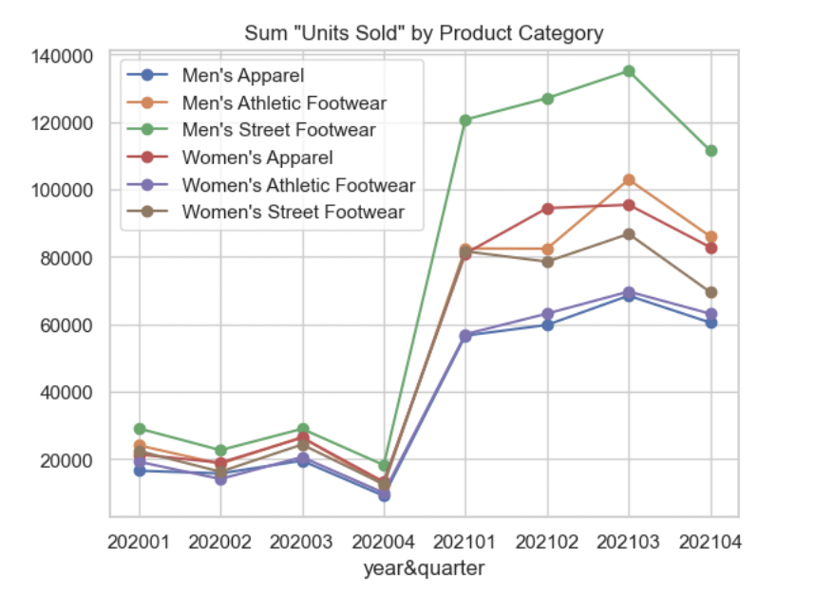
Sales Trends by Region and Product
Sales(Units Sold) by Region
Sales(Units Sold) by Product
Adidas sales over the region seems to recover from the pandemic in 2021 Q1 but yet not so stable
There has been an increasing disparity in sales across product categories

Slide 12
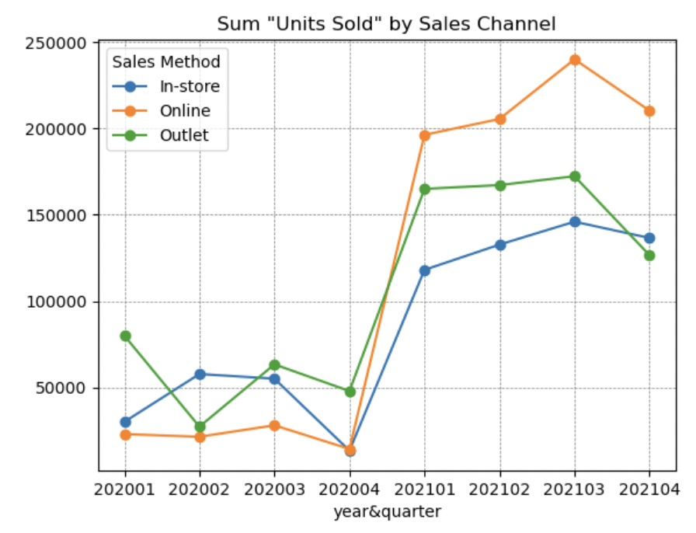
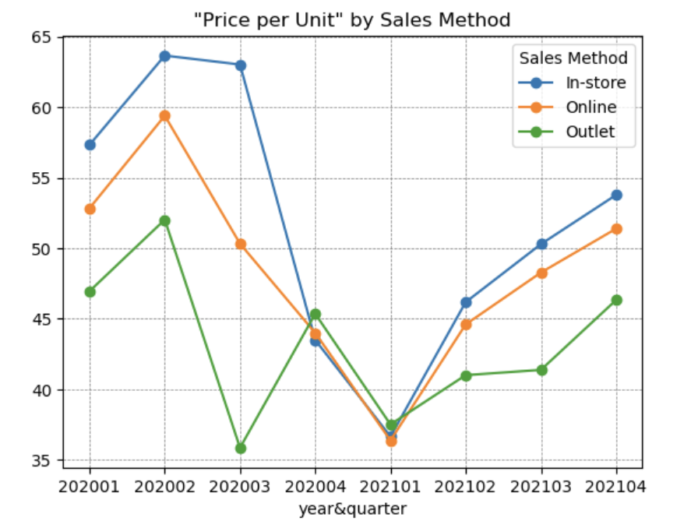
Sales Trends by Channel
Units Sold by Channel
Price per Unit by Channel
During the pandemic, Online became the sought-after channel for adidas
Overall cut-down in price per unit explains the sharp increase in units sold in 2021
Notes:
Based on our EDA, one of our hypothesis was that
For the second graph - while Online remained its price per unit in the middle level, it made best out of it given its highest level of units sold.

Slide 13

02
General Models
Multiple Linear Regression & Random Forest

Slide 14
Data Preprocessing
To predict ‘Units Sold (sale)’
Dropping the derived variables columns
Creating
month and year columns
Dummy Encoding Categorical Variables
- Operating margin
-Operating profit
- Total Sales
- Retailer info
- Year (2020, 2021)
- Month (Jan-Dec)
- Region, City, State
- Product Category
- Sales Channel
- Year, Month
Region, State, City, Product, Price per Unit, Units Sold, Sales Channel, Year, Month

Slide 15
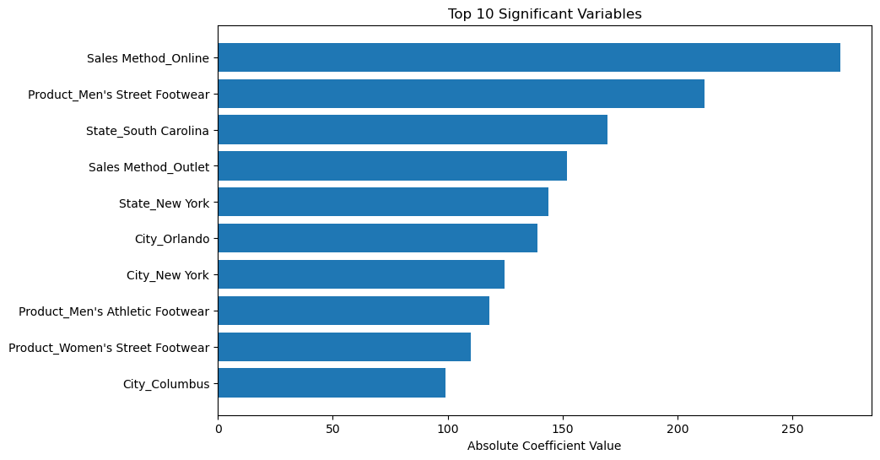
Multiple Linear Regression
Feature Importance
Pointers
Train-test split :
80% - 20%
F- Statistic : 124.6
Significant variables cutoff at P-value < 0.05

Slide 16
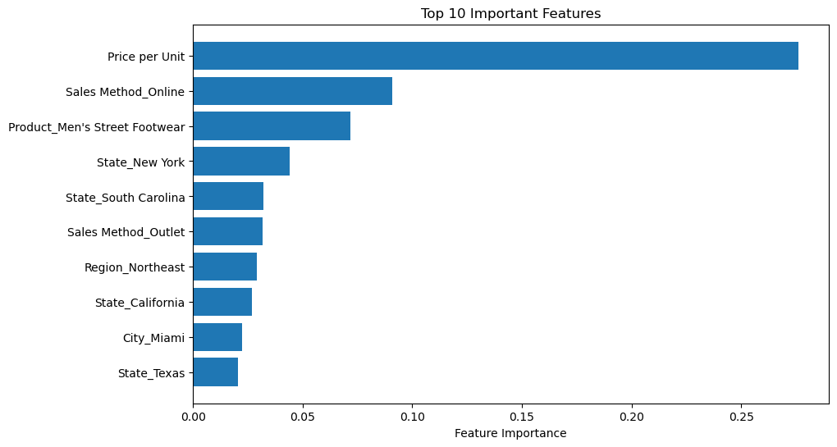
Random Forest
Feature Importance
Pointers
Train-test split :
80% - 20%
5 fold cross validation based on MSE score
Optimal number of trees: 1000

Slide 17
Model Comparison
/ Performance
/ Comments
Parameter | Random Forest | MLR
Test MSE | 11,680 | 21,293.19
Test R-Squared | 0.75 | 0.55
Best n_estimators (through Cross Validation) | 1000 | -
There are non-linear relationships and interactions between variables that Random Forest is capturing but Linear Regression is not.
Hence we can consider variable feature importance from Random Forest
Hence Price Per Unit, Sales methods and a couple of demographic variables for states and regions can be noted as most important

Slide 18
03
Price
Elasticities

Slide 19
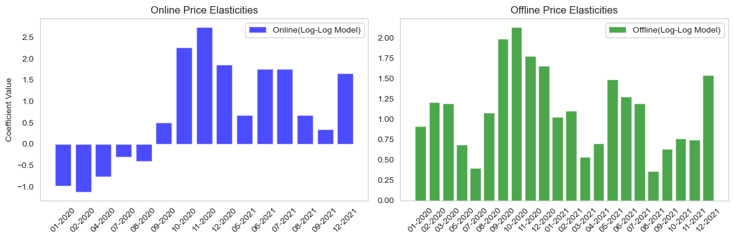
Price Elasticities by Sales Channel
Customers shopping online tended to compare prices more actively at the onset of Covid-19
Shift in 2021 : Likely attributed to regional or product type level changes in customer behavior and skews
Positive price elasticities during Covid-19
In-store visits might have led to purchases regardless of prices due to product try-ons

Slide 20
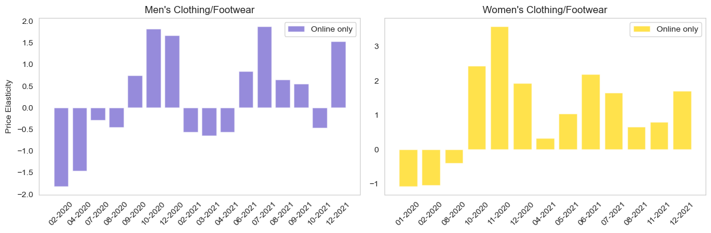
Price Elasticities by Product Type
In contrast, women's products continued to sell well even when prices increased.
Cognitive Bias : Higher prices → better quality.
Limited traditional shopping options during covid → Increased online shopping
Men's products showed a decrease in sales when prices went up in 2020 and 2021

Slide 21
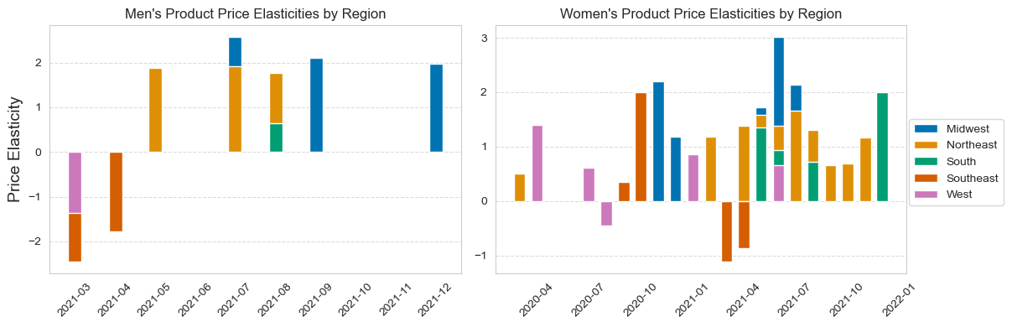
Product Price Elasticities by Region
Limited data points for online men’s category sales in 2020 resulted in insignificant coefficients
North east, Midwest and South : Higher disposable incomes and population density combined with covid anxiety might explain the less price sensitivity
Southeast and West : Negative price elasticities indicate higher price sensitivities and possible brand loyalty issues

Slide 22
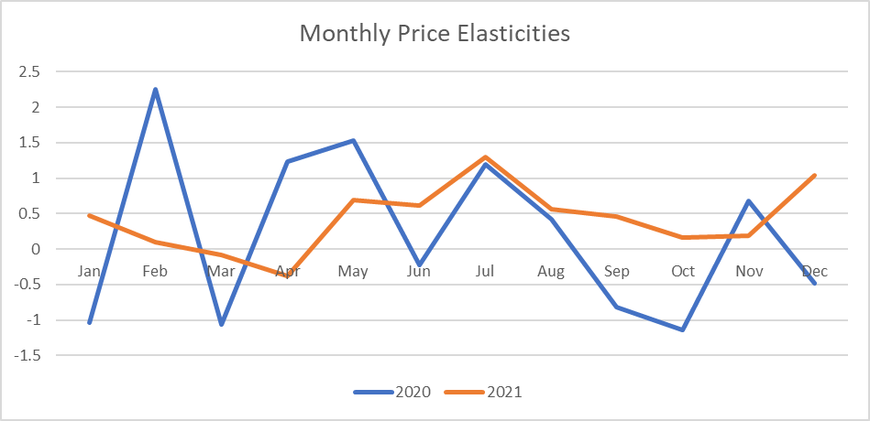
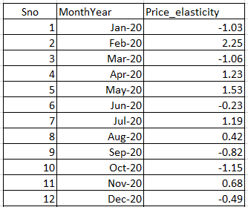
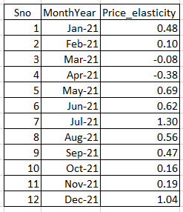
Monthly Price Elasticities
(using Hierarchical Bayes)
/ 2020
/ 2021
Monthly Price Elasticities
Month
Year
Price Elasticities
Month
Year
Price Elasticities
Hierarchical Bayes model suggests that for online sales channel the demand was mostly inelastic for 2021.
In 2020, price elasticity fluctuated from mostly positive in the first half to negative in the second half.

Slide 23
04
Conclusion
& Suggestion

Slide 24
Summary of the findings
/ Sales Strategy
/ Channel
Ensure competitive pricing in the online channel due to the distinctive price sensitive behavior observed in this domain
/ Category
Price increases in the men’s product categories negatively impact the sales volume - targeted promotional offers to offset sales decrease
/ Region
Prioritize high margin sales in regions with low price sensitivity - Northeast, South and Southeast

Slide 25
THANKS!
DO YOU HAVE ANY QUESTIONS?

Slide 26
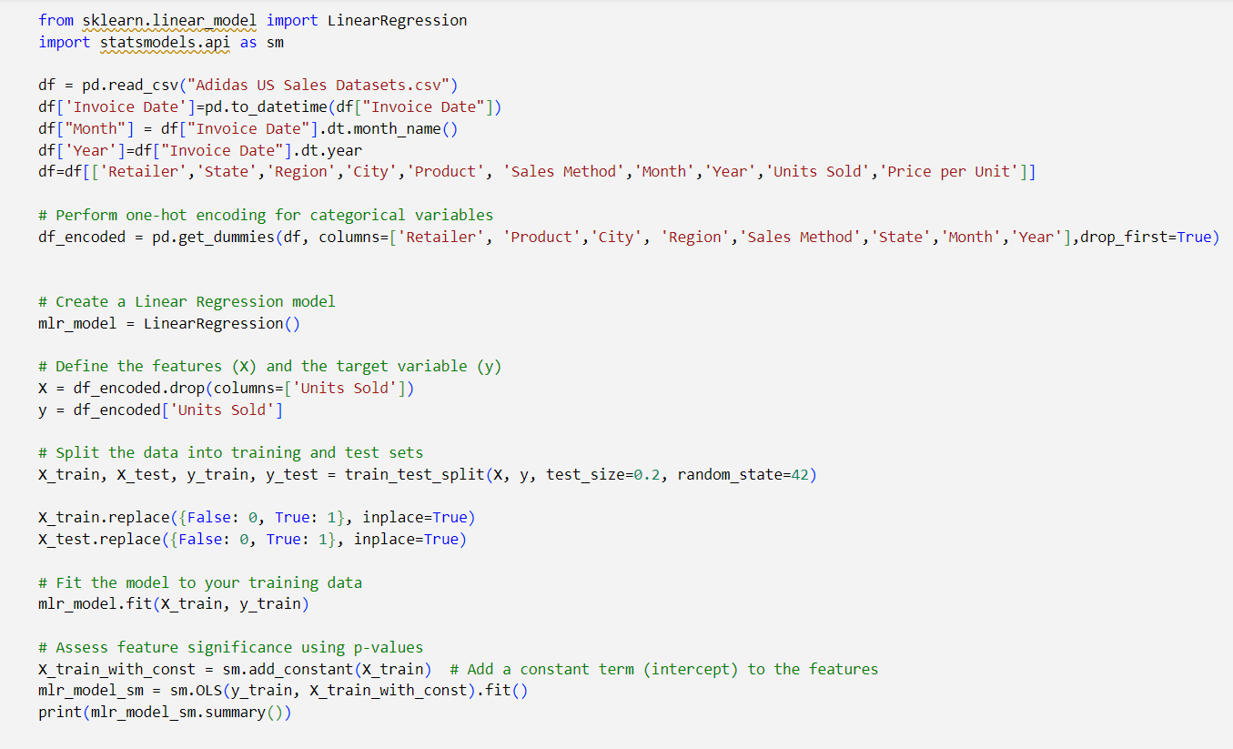
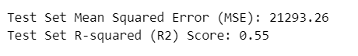
Appendix
Multiple Linear Regression

Slide 27
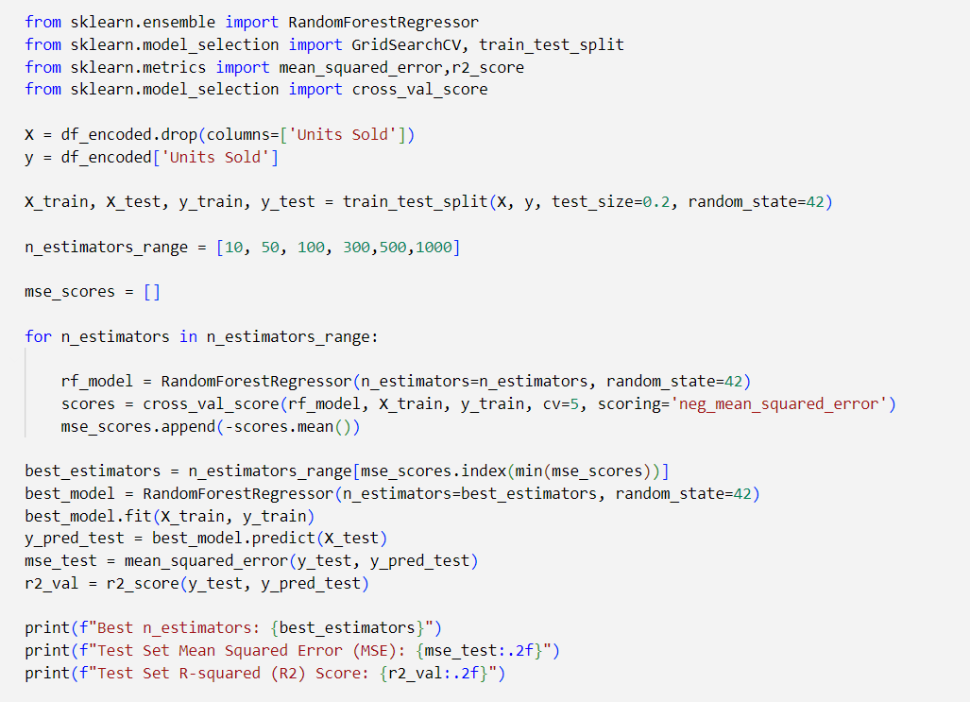
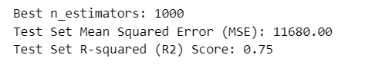
Appendix
Random Forest Regressor

Slide 28
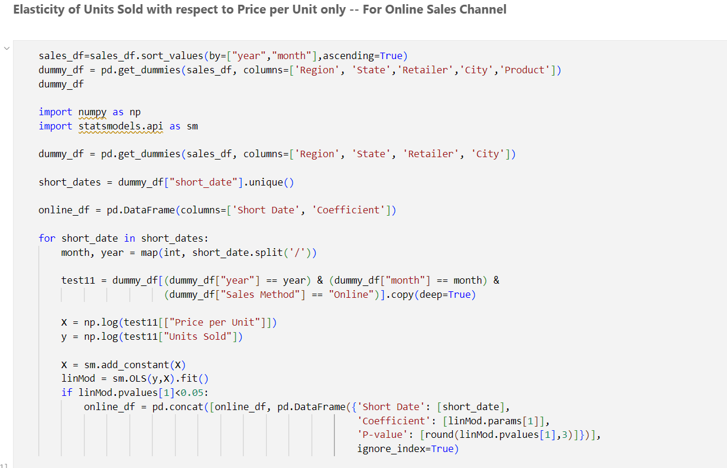
Appendix
Price Elasticity of Units Sold - Online Channel Only

Slide 29
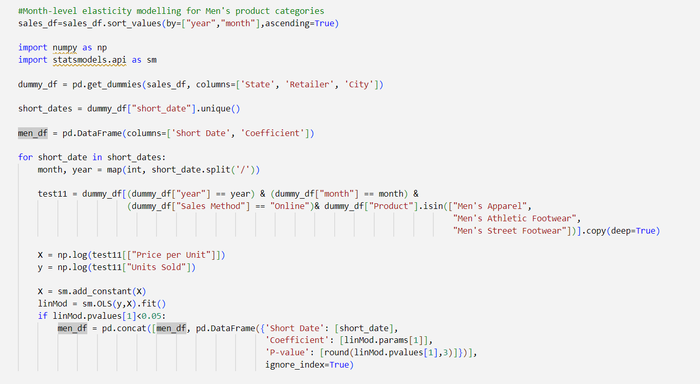
Appendix
Price Elasticity - Online + Men’s Product Categories

Slide 30
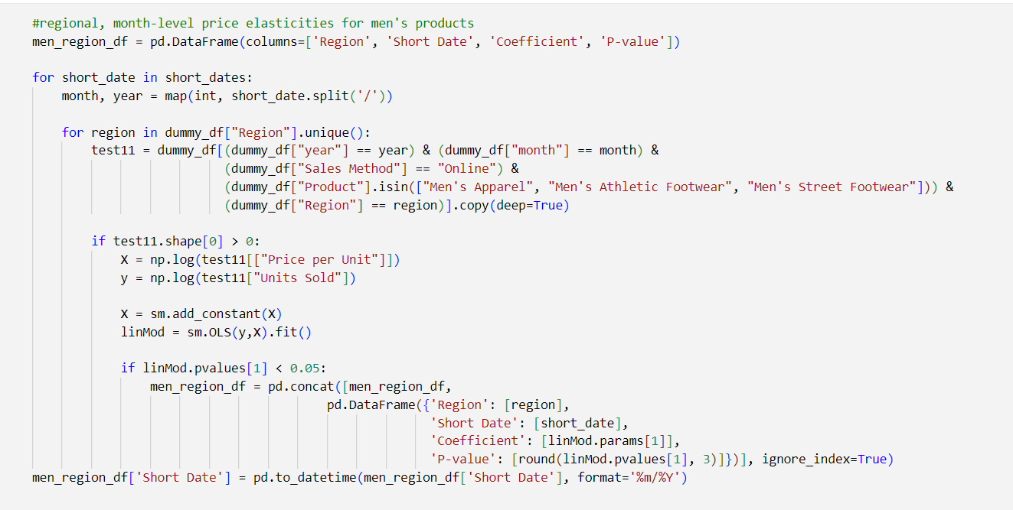
Appendix
Regional Monthly Price Elasticities - Online + Men’s Product Categories

Slide 31
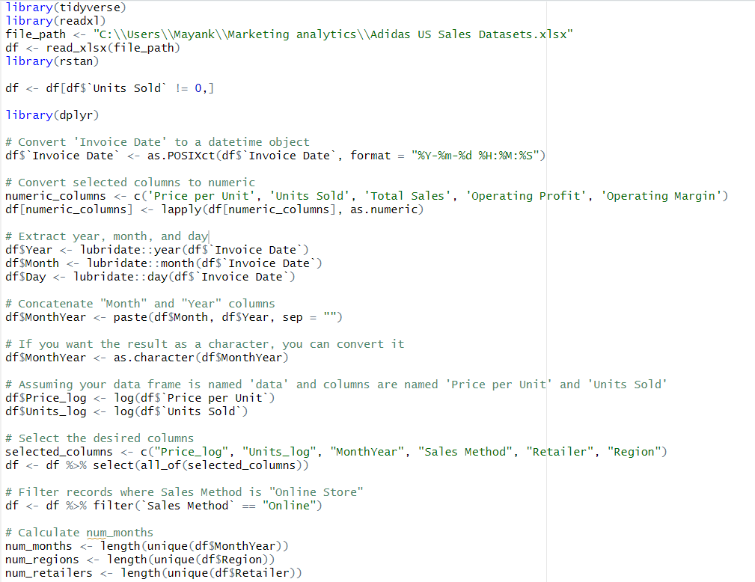
Appendix
Hierarchical Bayes Price Elasticity Modelling (1/3) -
Monthly Elasticities + Online Channel + Both Product Types

Slide 32
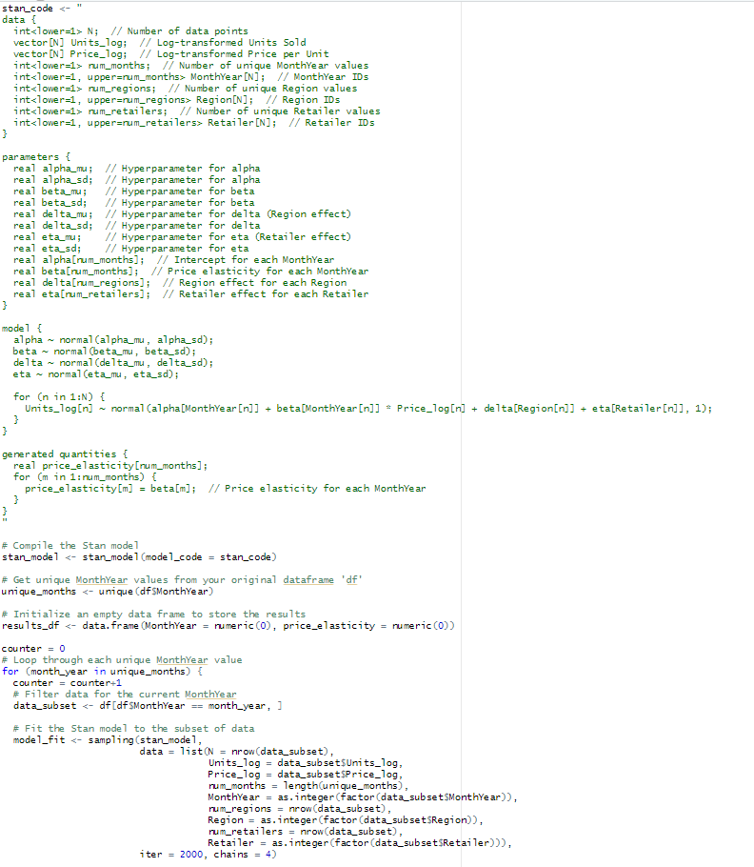
Appendix
Hierarchical Bayes Model -
Continued(2/3)

Slide 33
Appendix
Hierarchical Bayes Model -
Continued(3/3)

Slide 34
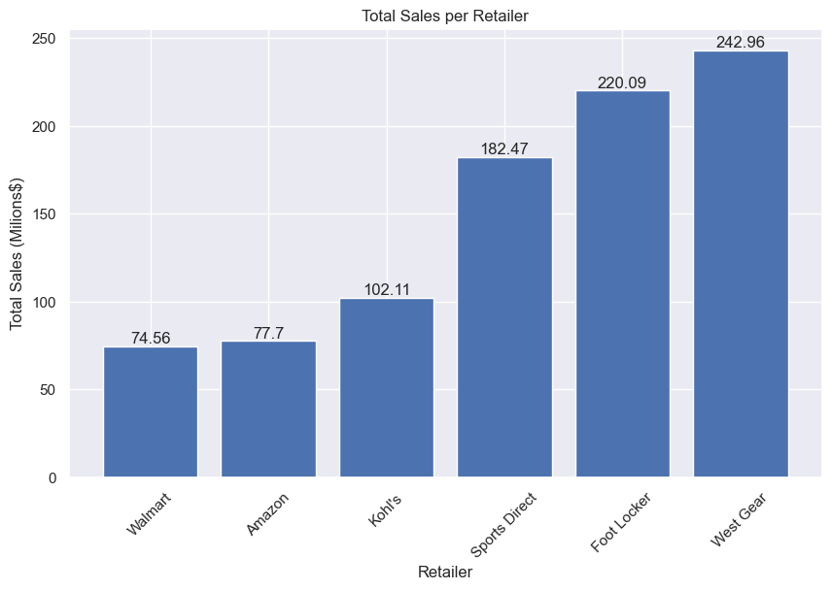
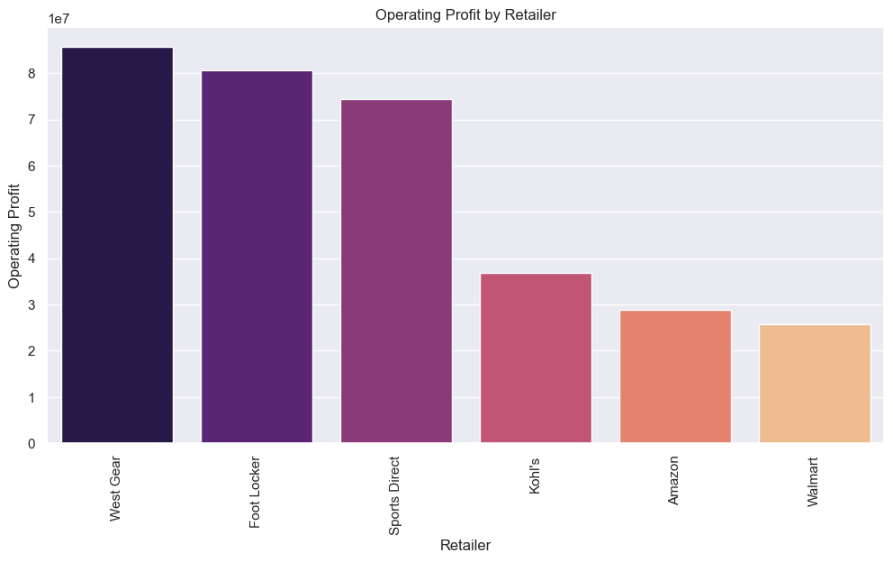
Revenues and Profit by Retailer
Total Revenues by Retailer (Million$)
Operating Profit by Retailer
West Gear, Foot Locker, Sports Direct are the top 3 Retailers for Adidas Sales
Retailer's Total Revenue and Operating Profit generally show a proportional relationship
Notes:
Based on our EDA, one of our hypothesis was that
For the second graph - while Online remained its price per unit in the middle level, it made best out of it given its highest level of units sold.

Slide 35
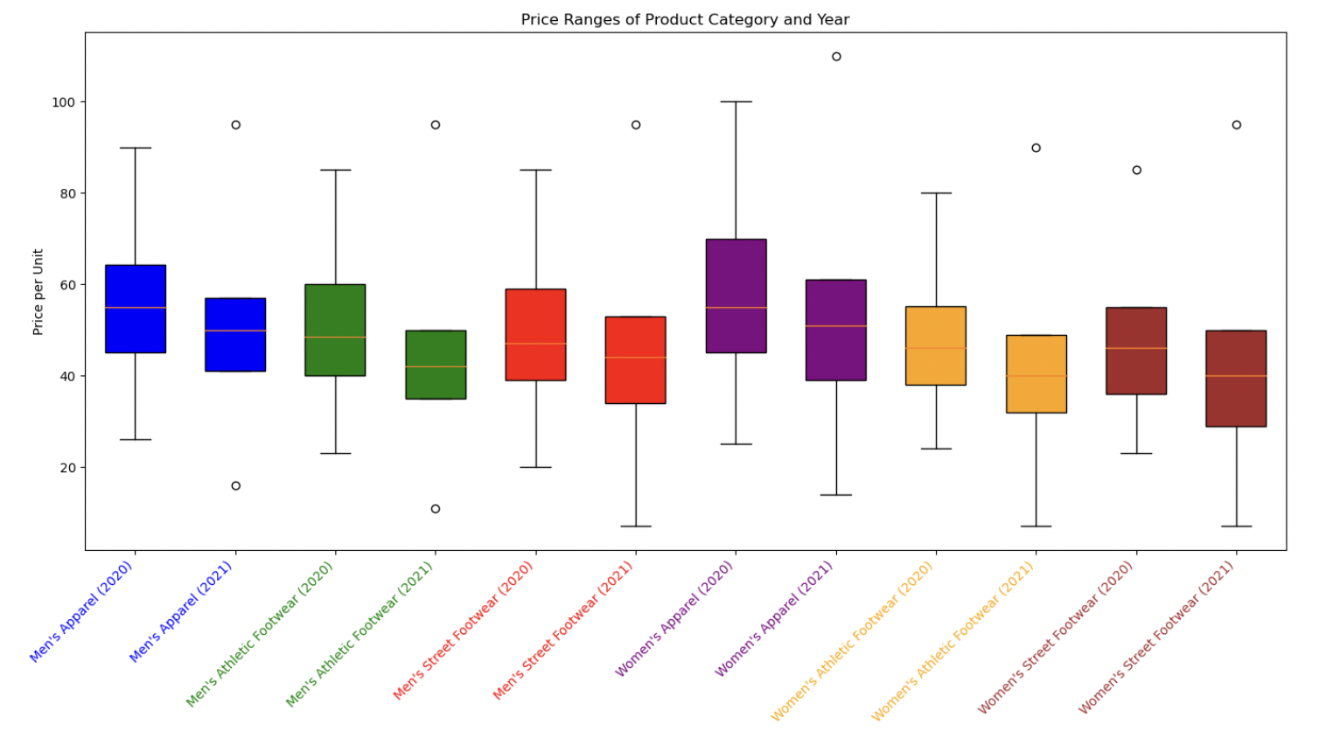
Price Ranges by Product

Slide 36
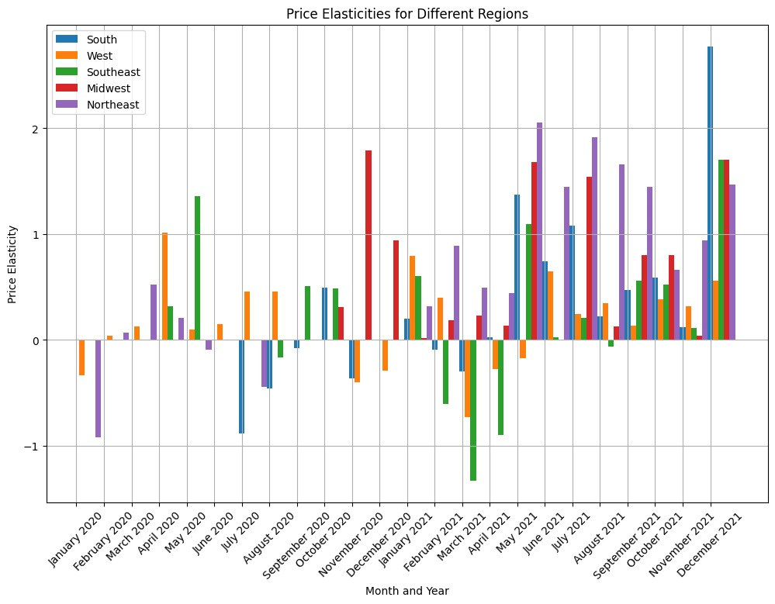
Price Elasticities for Different Regions

